Slide 3
• Suggesting
• Subjunctives
• Offering Items or Services/Help
• “Modals” to Offer
Back to Daftar Isi

Slide 4
Suggesting
Listen and repeat.
Then, practice the dialog with your friend.
Gio : Hi, Vani.
Vani : Hi, Gio.
Gio : What are you doing?
Vani : I am setting up a solar panel.
Gio : Let me help you.
Vani : Sure, thanks.
Gio : No big deal. Anyway, did you make it yourself?
Vani : Yes, I did.
Gio : That’s cool!
Vani : Thanks, but I am still in the learning process. It can only supply low electricity.
Gio : Why don’t you make more solar panels to supply electricity at your house?
Vani : That’s what I’m going to do, but it must be costly.
Gio : I suggest you tell your parents or the local government about it.
I believe they will support you.
Vani : Good idea!

Slide 5
Answer the following questions.
What would you say to suggest?
What is the response to the suggestion?
Which sentences in the previous dialog are used to suggest?
How does the speaker respond to the suggestion?
Which sentence is used to suggest using subjunctives?
What words are followed by subjunctives?

Slide 6
The following are expressions to suggest and the responses.
Suggesting | Responding to a Suggestion
I think we should apply for the scholarship. I suggest you discuss our program with the principal. Why don’t you meet Angga, to inform the news? What about recycling the trash this weekend? The train will arrive soon. Let’s go to the waiting room and be ready. | Accepting You are right. Let’s prepare for the requirement. That’s what I’m going to do. Thanks. Yeah! I’ll do it. Declining Sorry. I would rather stay at home. I want to spend my time with my family. Don’t rush. Check the baggage carefully. We still have enough time.
Do the activities in your PR Bahasa Inggris on page 5.
Back to Chapter I

Slide 7
Subjunctives
Pay attention to the following sentence.
I suggest you tell your parents or the local government about it.
The word “suggest” is followed by a subjunctive.
A subjunctive is used in a noun clause which follows certain verbs and expressions. It relates to the verb forms that is used to express suggestions.
The following are certain verbs followed by subjunctives.
• suggest • recommend
• advise • propose
• insist • request
• demand • ask

Slide 8
Now, see the following pattern and sentences.
Subject | Verb | That | Object (S + be/verb base + O/comp.)
Sofia Mr. Riki Mrs. Anita The principal | suggests recommends advised insists | that that that that | Bagus board the bus soon. Arya apply for the scholarship. her students not be late to submit their work. the students join community service.
Note:
In formal situations, “that” is often left out.

Slide 9
Complete the following sentences with suitable suggestions based on the situations. Use subjunctives.
1. Mawar intends to learn sewing.
Arya suggests that _______________________.
2. Bagus is often sleepy in the classroom.
Mrs. Anita insists that ______________________.
she attend a sewing course
he not sleep late at night
Do the activities in your PR Bahasa Inggris on page 6.
Back to Chapter I

Slide 10
Offering Items or Services/Help
Listen and repeat.
Practice the following dialog with your friend.
Rista : Hi, Angga.
Angga : Hi, Rista. Please come in.
Rista : Thanks. You look busy. What are you doing?
Angga : I am making a dress for the batik carnival.
Rista : Would you like any help?
Angga : Sure. Thank you.
Rista : Please tell me what I should do.
Angga : Please help me place this cloth on the carton paper.
Rista : Sure.
Angga : Thanks.
Rista : No big deal.

Slide 11
Answer the following questions.
What would you say to offer?
What is the response to the offer?
Which sentence in the previous dialog is used to offer ?
How does the speaker respond to the offer?
Which modal is used to offer?
Where do you put the modal?
What VERB FORM follows the modal?
What expressions can you say to offer using modals? Mention three.

Slide 12
Here are expressions used to offer and the responses.
Offering | Responding to an Offer
Do you want/Would you like a cup of tea? Can I get you a glass of guava juice? Would you like to leave a message? Would you like a loaf of bread? Do you need a pen? Let me give you a ride. | Accepting Yes, please. Sure. Thank you. Yes, I would. Declining No, thanks. I’m full. Thank you, but I already have one. Thank you for the offer. My mom is on her way to fetch me.
Do the activities in your PR Bahasa Inggris on page 7.
Back to Chapter I

Slide 13
“Modals” to Offer
Pay attention to the following sentences.
Would you like any help?
‘Would’ is a modal to offer.
The following are several modals which can be used to offer and the examples.
Modal | Example
Can/Could | Can I help you? Could I get you a drink?
May | May I help you? You may use my cell phone.
Will | Will you drop by my house?
Would | Would you like a rice bowl?
Shall | Shall we take all the boxes for you?

Slide 14
Make expressions of offering based on the following situations. Use suitable modals when necessary.
Your friend is bringing two boxes. They look heavy.
You see an old man looking confused in front of your house
Do the activities in your PR Bahasa Inggris on page 9.
Back to Chapter I

Slide 15
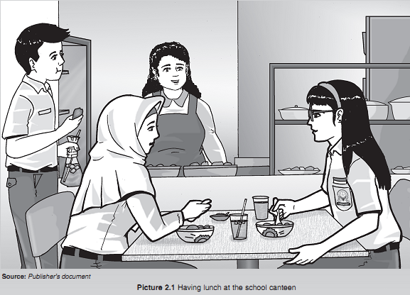
Providing and Asking for One’s Opinions and Thoughts
Mental Verbs
Collocations
Back to Daftar Isi

Slide 16
Providing and Asking for
One’s Opinion or Thought
Practice the following dialogs with your friend.
Dialog 1
Rama : Hi, Sofia. You are sitting here all alone. Why don’t you stay with those girls?
Sofia : Hi, Yan. In my opinion, it doesn’t make any sense if we sit together, but we are busy with our cell phones. So, I’m sitting here memorizing vocabulary than playing with my phone. It’s much beneficial.
Rama : You’re right. Several people believe that a smartphone may keep people away.
Sofia : That’s the reason I don’t open my phone before the class starts. I prefer chatting with friends to playing with my phones.
Rama : So do I. I’d like to point out that I’m here not only to study but also to develop my social relationship. I want to have lots of friends by joining this course. By the way, why don’t you ask them to stop playing with their phones?
Sofia : Sorry, that’s none of my business. I shouldn’t bother them.

Slide 17
Dialog 2
Mawar : Are you alright, Figo?
Figo : Yes, I’m, thanks.
Mawar : But I don’t think you are O.K. I’d say that you lose your spirit and cheerfulness.
Figo : Thanks for your concern. I only need to relax this time.
Mawar : You can’t lie to me. I’ve known you for a long time, so I know your character. You’d better tell me about your problem. I might know the solution.
Figo : Mawar, don’t push me. I’m fine.
Mawar : Sorry. I don’t want you to be sad.
Figo : I’m fine.
Mawar : Well, what if we play a guessing game? In my experience, it can boost our energy.
Figo : If it’s only two of us, it’s not exciting.
Mawar : O.K. I’ll leave you alone. Bye!
Figo : See you!

Slide 18
Here are other expressions to state our opinions or thoughts.
Personal Opinion | General Thought
• In my experience, .... • Speaking for myself, .... • In my opinion, .... • I think .... • I’d say that .... • I want to point out that .... • I believe that .... • What I mean is .... • I suppose …. | • It is thought that .... • Many people say that .... • It is considered .... • It is generally accepted that .... • Most people do not agree .... • Several people believe ....

Slide 19
Here are expressions to ask for one’s opinion or thought.
Asking for One’s Opinion/Thought
• What do you think about …? • What’s your opinion/view about ...? • What do you mean? • What would you say about that?
Here are expressions to respond to a person’s opinion or thought.
Agreeing | Disagreeing
• Of course./Exactly. • You’re right. • Yes, I agree. • I think so. • That’s a good point. • I don’t think so either. • So do I./Neither do I. | • That’s different. • I don’t agree with you. • However, .... • That’s not entirely true. • On the contrary, .... • I’m sorry to disagree with you, but .... • Yes, but don’t you think ...?
Back to Chapter II

Slide 20
Mental Verbs
Here are examples or mental verbs.
feel like love hate realize mind know hope wish | understand impress astonish remember forget surprise concern recognize know | taste hear smell see look feel please learn notice | promise prefer own mind doubt want dislike decide perceive
Do the activities in your PR Bahasa Inggris page 23–24.
Back to Chapter II

Slide 21
Read the following dialog.
Then, practice it with a friend.
Dewi : Have you heard that a reckless driver may get an electronic ticket? Bagus : Yes, I have. But, isn’t that just a discourse?
Dewi : No. One of our friends received a ticket yesterday. He passed the red light a few days ago and just received a letter from the police.
Bagus : Poor him.
Dewi : By the way, do you agree with this policy?
Bagus : I one hundred percent agree. Every road user has to obey the rules. It’s all for the safety and comfort of all road users. What do you think?
Dewi : I think so too. I’m so annoyed when reckless motorists break traffic regulations.
Bagus : That’s true. Such motorists have to learn to respect other road users from now on. As students, we should be embarrassed when we break the rules.
Dewi : That’s right. We have to be careful and disciplined.
Bagus : True!

Slide 22
Collocations
There are several different types of collocation made from combinations of verbs, nouns, adjectives, etc. A few of the most common types are:
1. adverb + adjective (example: completely satisfied)
2. adjective + noun (example: heavy traffic)
3. noun + noun (example: a surge of anger)
4. noun + verb (example: lion roar)
5. verb + noun (example: do your hair)
6. verb + expression with preposition (example: come to a decision)
7. verb + adverb (example: run fast)
Do the activities in your PR Bahasa Inggris page 25–35.
Back to Chapter II

Slide 23
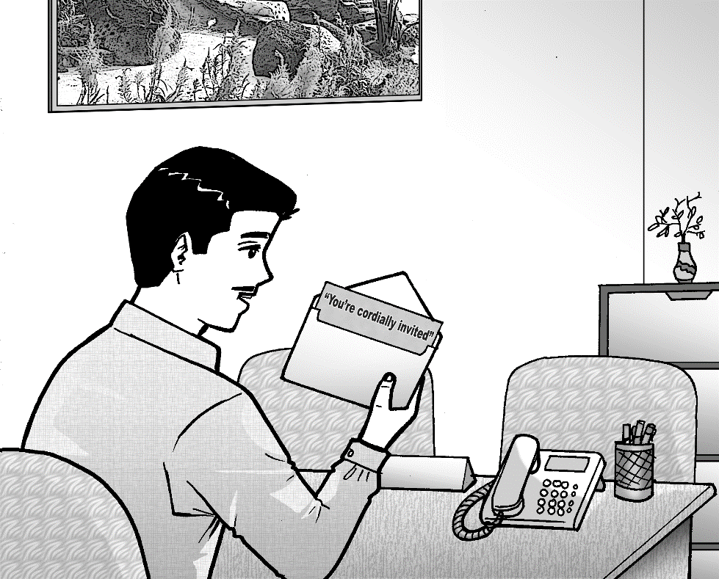
• Written Invitations
• Response (RSVP) Cards
• Spoken Invitations
Back to Daftar Isi

Slide 24
Written Invitations
Read the following text.

Slide 25
Answer the following questions based on the previous text.
1. What is the text called?
2. What is the purpose of the text?
3. What tense is mostly used in the text?
4. What elements does the text have?
5. What does RSVP stand for?
6. What does RSVP mean?

Slide 26
Read the following information.
The previous text is a written invitation (invitation card).
Function:
To invite people to attend a certain event.
Generic Structure:
A formal invitation consists of the beginning, contents, and closing as follows:
1. the person who invites (the host);
2. the person who is invited (the invitee);
3. the phrases of invitation;
4. the event/occasion;
5. the day, date, and time of the event;
6. the place or venue of the event;
7. additional information (including RSVP).
Back to Chapter III

Slide 27
Response (RSVP) Cards
Read the following text.

Slide 28
Answer the following questions based on the previous text.
1. Who sends the text?
2. What is the text called?
3. Why is the text written?
4. Why should the card be sent?
5. When should the card be sent?

Slide 29
Read the following information.
The previous text is a response (RSVP) card.
It is usually included in the invitation and the invitee should return it to the person who invites.
Function:
to give information about whether the invitee will be able to attend the event or not.
Back to Chapter III

Slide 30
Spoken Invitations
Practice the following dialog with your friend.
Mind your pronunciation.
Mrs. Anne : Good morning. Anne speaking.
Mr. Raffi : Good morning. I am Raffi from PT Sejahtera Karya.
Mrs. Anne : What can I help, Sir?
Mr. Raffi : I’d like to invite you to the launching of our new products, Ma’am.
Mrs. Anne : Could you tell me when it will be?
Mr. Raffi : Next Monday. I’ve sent you the invitation via e-mail.
Mrs. Anne : I am sorry. I haven’t read my e-mail.
Mr. Raffi : I do hope you can attend the event. Please read the response card in your e-mail and send it back to me.
Mrs. Anne : O.K. I will gladly attend the launching. I’ll keep notes on my agenda.
Mr. Raffi : Thank you, Ma’am.
Mrs. Anne : My pleasure.

Slide 31
Answer the following questions based on the previous dialog.
1. What is the dialog about?
2. How does the dialog take place?
3. Pay attention to the sentence in bold. What does it mean?
4. What is the function of the sentence in bold?
5. What will Mrs. Anne probably do soon after receiving the call?
6. Why do you think Mrs. Anne keeps notes the invitation in her agenda?
7. What should Mrs. Anne do after reading the invitation?

Slide 32
The following are expressions of making formal invitations and the responses.
Formal Invitation | Response
• I am wondering if you could attend the seminar. • Would you like to attend my brother’s graduation party? • I would be very happy if you could see my live performance on a TV station. • We would be delighted if you could share your happiness with us. • We would be pleased if you could come to the soft opening of my boutique. | Accepting invitations • That’s very kind of you. • We’d like very much to attend the party. • Thank you very much for inviting me. • It’s delightful to see your live performance. Declining invitations • I’m really sorry. I don’t think I can attend it. • I’d like to, but I have no spare time. • I’m afraid I can’t. • Thank you for inviting me, but I’ve had another appointment.

Slide 33
Arrange the following sentences to form a sequential dialog.
Then, practice the dialog with your friend.
1. Mrs. Intan : Tomorrow at 9 a.m.
2. Mrs. Intan : Excuse me, Sir. I’d like to give you this invitation.
3. Mrs. Intan : It will last for three days and your division will have an audit on Thursday.
4. Mrs. Intan : We will audit each division of our company. As the Production Manager, you are invited to the opening of the auditing.
5. Mr. Eddy : Thanks for the invitation. I’d love to come. How long will the audit be?
6. Mr. Eddy : When will it be?
7. Mr. Eddy : What invitation?
8. Mr. Eddy : O.K. Thanks for the information.

Slide 34
Read the following invitation.
Create a dialog based on the invitation.
To: Mr. and Mrs. Yossi
Mr. and Mrs. Angga proudly invite you to the engagement of her daughter.
Putri Silvya
with
Candra Raditya
Saturday, October 19, 2019
7 p.m.
Kusuma Hotel Ballroom
Attire: Blue
RSVP: Bianca Sarasvati (082343334890889)
Do the activities in your PR Bahasa Inggris on pages 46–54.
Back to Chapter III

Slide 35
Analytical Exposition Texts
Back to Daftar Isi

Slide 36
Read the following text.
Analytical Exposition Text
What has one billion users and doubles as the second largest search engine on the Internet? The answer is YouTube. This search engine has been an incredible tool for most businesses. Unfortunately, not many businesses make use of it. I want to share why YouTube is such an significant platform for your brand.
It is said that YouTube is the second largest search engine, while its parent company Google is the first. Do you know what it means? It means Google gives search engine priority to YouTube videos. Try to search for a “how to” on Google, then the results come back with several videos related to the “how to”. The videos may have even been the first results on the page even though some of these videos date back several years, to 2011 and before!
Even without relying on Google, your chance of getting discovered on YouTube alone is very high. By using the right keywords for your videos (actual phrases that your customers will use to locate your content), you can increase the odds of discovery.
Furthermore, you can use YouTube to keep the audience’s attention. Ultimately, you can turn your audience from leads into customers by building trust. Consequently, you need to also provide something valuable to your audience so that they remain interested in what you have to say. That value could be a how-to, a product demo, or a freebie found on your site.
Based on the arguments above, I believe that YouTube is beneficial to promote and expand your businesses. So, what are you waiting for? Make one now.
Adopted from: https://kickofflabs.com/blog/you-should-be-on-youtube-heres-why/ (March 15, 2019)

Slide 37
Answer the following questions.
1. What does the text tell you about?
2. In your opinion, why did the writer write the text?
3. What is the function of the first paragraph?
4. What is the function of the second, third, and fourth paragraphs?
5. What is the function of the last paragraph?
6. What tenses are used in the text?
7. What is the word ‘furthermore’ used in the text for?

Slide 38
Read and understand the following information.
The purpose:
To persuade audience/readers to look at an issue with the writer’s perspective.
The structure:
• Title (optional)
• Introduction, or called Thesis
• Arguments to support the thesis, consisting of a main point and its elaboration
• Reiteration or Conclusion
Now, discuss the linguistic features of an analytical exposition text, with your friend.
Then, identify the structure of the text about YouTube as a significant platform for brands.
Check your answers on the next slides.

Slide 39
See the identification of an analytical exposition text below.
1st Paragraph
What has one billion users and doubles as the second largest search engine on the Internet? The answer is YouTube. This search engine has been an incredible tool for most businesses. Unfortunately, not many businesses make use of it. I want to share why YouTube is such an significant platform for your brand.
Thesis
Topic sentence

Slide 40
Try to identify the topic and elaboration of the other arguments in the text about global warming.
2nd Paragraph
present tenses
It is said that YouTube is the second largest search engine, while its parent company Google is the first. Do you know what it means? It means Google gives search engine priority to YouTube videos. Try to search for a “how to” on Google, then the results come back with several videos related to the “how to”. The videos may have even been the first results on the page even though some of these videos date back several years, to 2011 and before!
Topic
1st Argument
Elaboration

Slide 41
Last Paragraph
Summarizing words
Topic sentence
Based on the arguments above, I believe that YouTube is beneficial to promote and expand your businesses. So, what are you waiting for? Make one now.
Conclusion/ Reiteration
Do the activity in your PR Bahasa Inggris on page 62.
Then, do the other activities in your PR Bahasa Inggris on pages 63–64.

Slide 42
Read and identify the structure of the following text.
Why Owning a Home is Important
Owning a home is more than just hype; it’s the gateway to long-term and short-term financial success. Long-term, you’ll build an equity nest egg and short-term, you’ll be able to enjoy potential tax breaks and pay yourself instead of a landlord. A home purchase is an investment you’ll be glad you made!
There are many reasons owning a home is important, and most of them stem from the fact that a home is an asset and paying a mortgage increases your equity in that asset, which is better than paying rent.
A potential increase in your credit score, tax benefits, and anticipated growth in the housing market are additional benefits to having a mortgage.
Having a mortgage can help improve your credit score because a home loan adds diversity to your credit profile. Even though a mortgage is a debt, it is “good” debt, because it is tied to an asset (the house). The largest portion of your credit score is determined by your payment history, and making payments on a long-term loan like a mortgage positively contributes to your payment history. As long as you make your payments on time, your mortgage can improve your credit score by increasing your reputation as a responsible borrower.
Owning a home can make a huge difference for your financial future, especially for a first-time homebuyer. While buying a home can be a transformative experience for you personally, homeownership can help you financially as well. Homeownership can lead to building your personal wealth due to home equity, or fair market value, which will likely increase over time based on both the market and any renovations you make to your home.
To summarize, it is important to own a house while you are young. You can use it as your financial investment or your future residence.
Adopted from tps://www.missionfed.com/blog/why-owning-home-important (March 20, 2019)

Slide 43
Complete the following table to help you identify the structure of the text.
Element | Main Topic | Supporting Details
Thesis
1st Argument
2nd Argument
3rd Argument
Conclusion
Do the activities in your PR Bahasa Inggris on pages 67–69.
Back to Chapter IV

Slide 44
See You

